Slide 1
Periodontal Disease

Slide 2
Periodontal Disease
Periodontitis, also called gum disease, is a serious gum infection that damages the soft tissue around teeth. Without treatment, periodontitis can destroy the bone that supports your teeth. This can cause teeth to loosen or lead to tooth loss.

Slide 5
Perio Charting
Periodontal charting is a way of measuring the space between a tooth and the gum tissue next to it. Your hygienist uses an instrument called a probe and gently inserts it into this space. The size of these pockets is an indicator of how healthy or unhealthy your gums and bone support are. During this time, they also check for any bleeding of the gums, and any gum recession.
The numbers that you might hear are the depths of the pockets around your teeth in millimeters. These indicate whether your gums are healthy, or if they’re starting to show signs of gum disease:
Areas that measure 1 to 3 millimeters and fit snugly around the tooth are healthy tissue.
Areas that measure 4 millimeters or deeper are cause for concern due to plaque and bacteria causing the tissue to be inflamed and pull away from the tooth.
Areas with higher readings tend to be more sensitive to probing. In severely diseased areas, sometimes probing depths can reach up to 12 millimeters. These problem areas are often referred to as periodontal pockets and are often challenging to keep clean at home.
Periodontal charting is important because it can help your hygienist identify gum disease. Early detection is crucial when it comes to something like gum disease because it can help decrease your chances of acquiring a harmful secondary health condition spread by the bacteria from the disease.

Slide 8
Gum Measurements

Slide 9
GINGIVITIS
Earliest State of Gum Disease
Gum Measurements 4mm
Gingivitis a common and mild form of gum disease, also called periodontal disease. It causes irritation, redness, swelling and bleeding of your gingiva, which is the part of your gum around the base of your teeth. It's important to take gingivitis seriously and treat it promptly. Gingivitis does not cause bone loss.

Slide 10
MILD PERIODONTITIS
Gum Measurements 5mm
Mild periodontitis is a stage of gum disease where gums pull away from teeth, creating pockets that trap plaque, tartar, and bacteria. These pockets are too small for floss and toothbrushes to reach, and the bacteria can damage teeth and cause early bone loss.
Mild periodontitis can develop when gingivitis, an early-stage gum disease, goes untreated. Gingivitis causes gums to become red and swollen, and may cause bleeding when brushing. However, gingivitis is reversible if you brush your teeth more often and visit the dentist regularly

Slide 11
MODERATE PERIODONTITIS
Gum Measurements 6mm
Left untreated, bacteria begin to erode the ligaments, soft tissues and bone that hold your teeth in place. You may notice bad breath and pus (infection) around your gum line. Some people develop pain at this stage.

Slide 12
ADVANCED PERIODONTITIS
Gum Measurements 7mm-10mm
As periodontal disease worsens, bone loss continues. This can cause your teeth to become loose and eventually fall out.

Slide 13
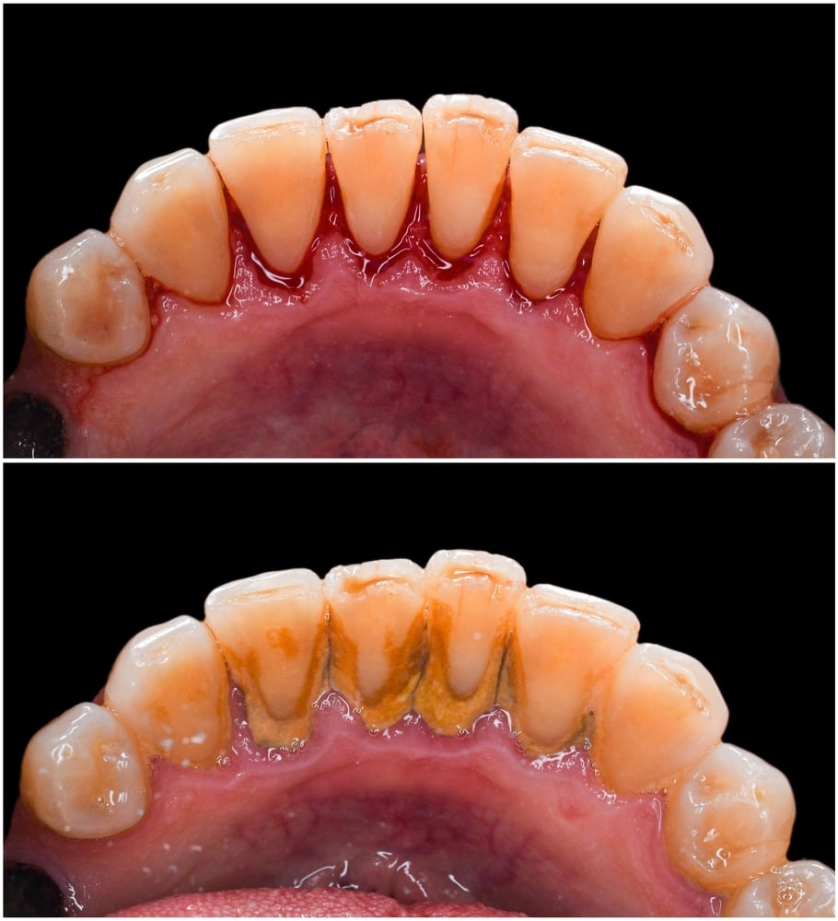
Scaling & Root Planing
Scaling and root planing is a deep cleaning below the gumline used to treat gum disease.
This deep cleaning has two parts. Scaling is when your dentist removes all the plaque and tartar (hardened plaque) above and below the gumline, making sure to clean all the way down to the bottom of the pocket. Your dentist will then begin root planing, smoothing out your teeth roots to help your gums reattach to your teeth. Scaling and root planing may take more than one visit to complete and may require a local anesthetic.
Scaling and root planing is a deep cleaning below the gumline used to treat gum disease.
After Scaling &
Root Planing
Before Scaling &
Root Planing

Slide 14
PERIODONTAL MAINTENANCE
Periodontal maintenance is for patients with periodontal disease. It may also be for those who had a periodontal procedure. This type of cleaning is deeper, targeting periodontal pockets. Gum maintenance removes tartar and plaque from the space between gums and teeth.
Perio Maintenance is usually every 3-4 months.

Slide 15
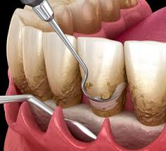
Osseous Surgery “Flap Surgery”
When advanced gum disease (periodontitis) develops, your teeth are in danger: At this stage, the ligaments and bone tissue that surround them are being destroyed, and you could even begin losing teeth! If the disease can't be controlled by non-surgical treatments like cleaning and scaling, then periodontal flap surgery may be your best treatment option.
Osseous surgery is a procedure that reduces the size of gum pockets caused by periodontal disease. It involves loosening the gums to expose the bone and gum, cleaning the area, and then suturing the gums into a new position. The procedure is similar to a deep cleaning and is usually relatively painless, though there may be some soreness afterwards.

Slide 16
The Goal of Flap Surgery
One major objective of flap surgery is to eliminate or reduce the pocket itself. To access it, a flap-like incision is made in the gum tissue. This allows us to remove diseased tissue from inside the pocket, and lets us access the teeth's root surfaces for a thorough cleaning, helping to eliminate harmful plaque and calculus (tartar). Afterward, the "flap" is closed, sealing the area. This begins the healing process, which takes place rapidly.
Another goal is the regeneration of periodontal ligament and bone tissue which may have been lost to the disease. We use a variety of techniques to accomplish this, including high-tech methods of bone grafting and chemicals referred to as growth factors. These approaches help restore the gums to their normal form and function, and promote the healthy and secure anchoring of teeth.

Slide 17
Notice how low the gums are versus the other healthy gum x-rays to the left.

